Slide 1

Deep Learning with Python
Copyright © www.ITbodhi.com

Slide 2
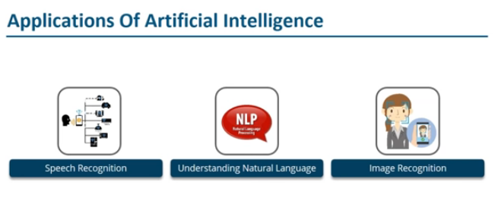
Copyright © www.ITbodhi.com

Slide 3
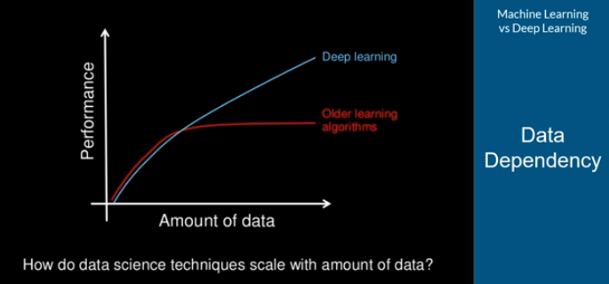
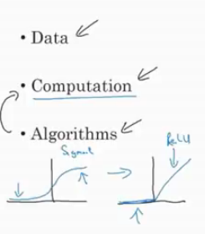
Machine Learning VS Deep Learning
Copyright © www.ITbodhi.com

Slide 4

Machine Learning VS Deep Learning
Copyright © www.ITbodhi.com

Slide 5
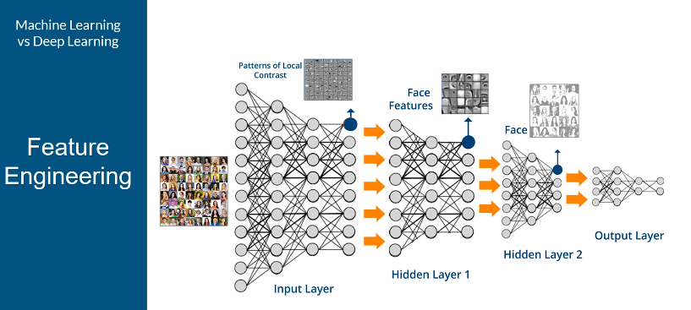
Machine Learning VS Deep Learning
Copyright © www.ITbodhi.com

Slide 6

Machine Learning VS Deep Learning
Copyright © www.ITbodhi.com
Notes:
Training: Higher for DL and lower for ML
Test: Just reverse
Like KNN, Naïve Biase

Slide 7

Machine Learning VS Deep Learning
Notes:
Training: Higher for DL and lower for ML
Test: Just reverse
Like KNN, Naïve Biase

Slide 8
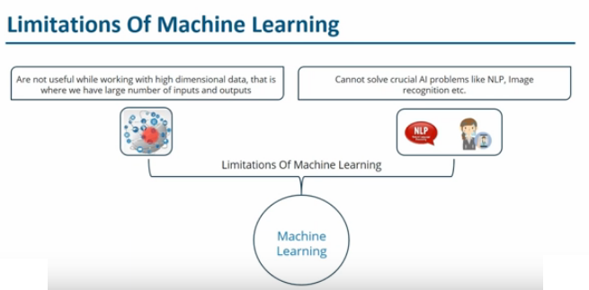
Copyright © www.ITbodhi.com

Slide 9

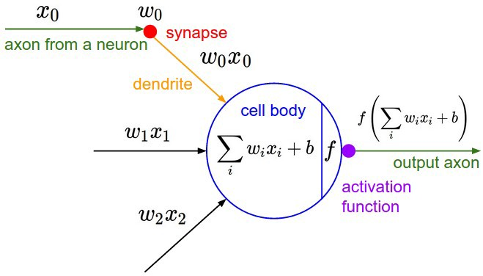
From Natural to Artificial
Copyright © www.ITbodhi.com

Slide 10
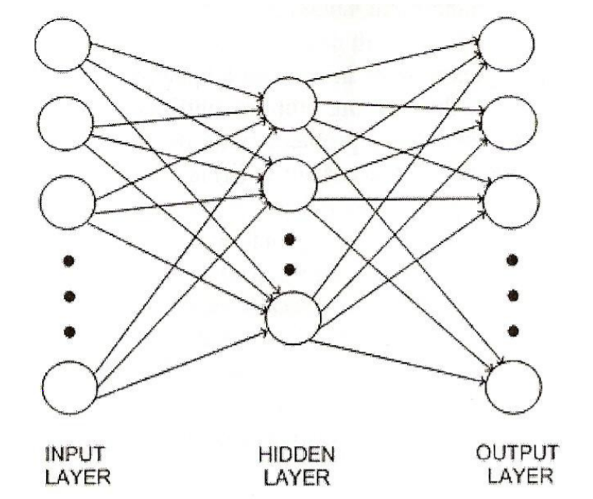
Artificial Neural Networks
Neural Network is a learning structure designed to mimic the function of a web of biological neurons.
A biological neuron takes an electric input and pops out another electrical signal. However, there is a threshold that must be reached before an output is produced.
The basic idea of the neuron model in ANNs is that the inputs to a neuron are combined (as a weighted sum) into a single value, Then, an activation function, is applied to determine whether or not the neuron fires.
Deep Learning can be understood as an algorithm which is composed of hidden layers of multiple neural networks
A function that takes an input signal and generates an output signal but takes into account some kind of threshold is called an Activation function.
The computational systems we write are procedural; a program starts at the first line of code, executes it, and goes on to the next, following instructions in a linear fashion. A true neural network does not follow a linear path. Rather, information is processed collectively, in parallel throughout a network of nodes (the nodes, in this case, being neurons)
Copyright © www.ITbodhi.com

Slide 11
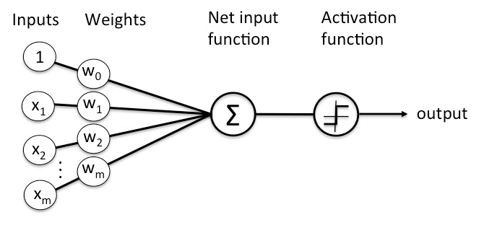
Perceptron : An Artificial Neuron
Copyright © www.ITbodhi.com

Slide 12
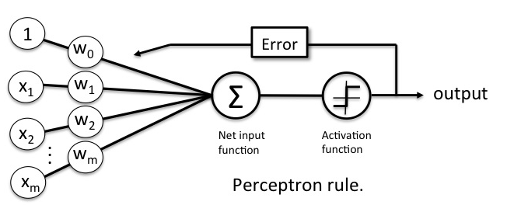
Perceptron : Learning Rule
Copyright © www.ITbodhi.com

Slide 13
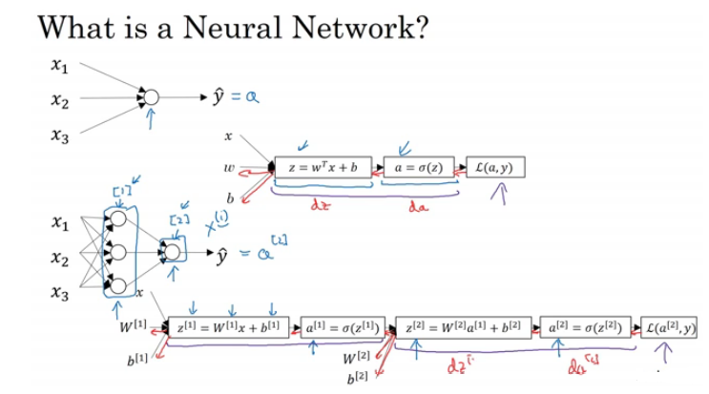
Perceptron : Learning Rule
Copyright © www.ITbodhi.com

Slide 14
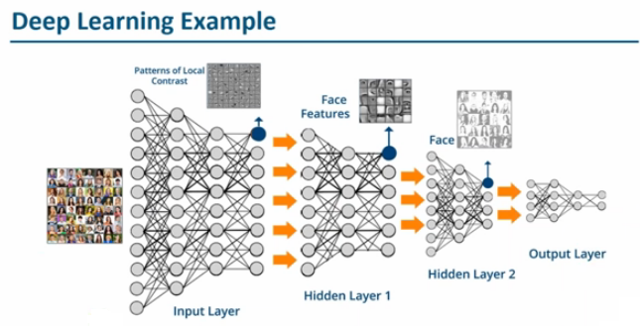
Copyright © www.ITbodhi.com

Slide 15
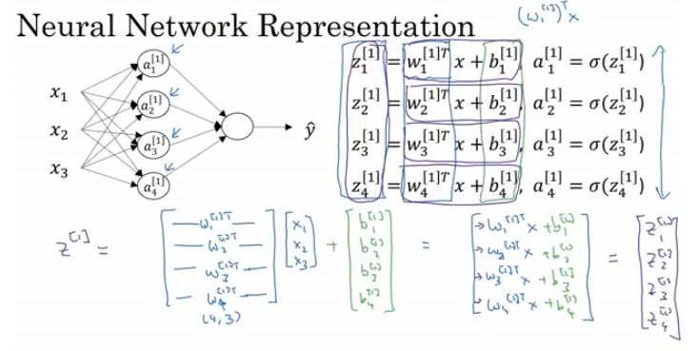
Copyright © www.ITbodhi.com

Slide 16
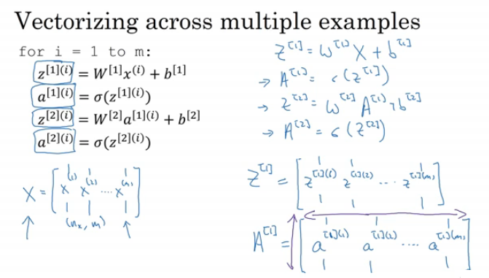
Copyright © www.ITbodhi.com

Slide 17
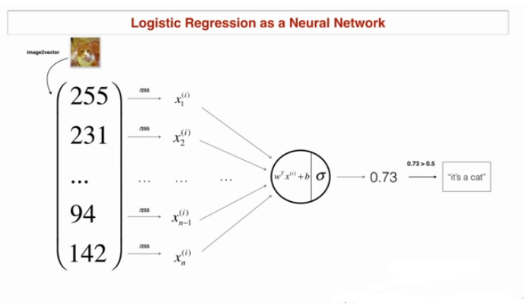
Copyright © www.ITbodhi.com

Slide 18
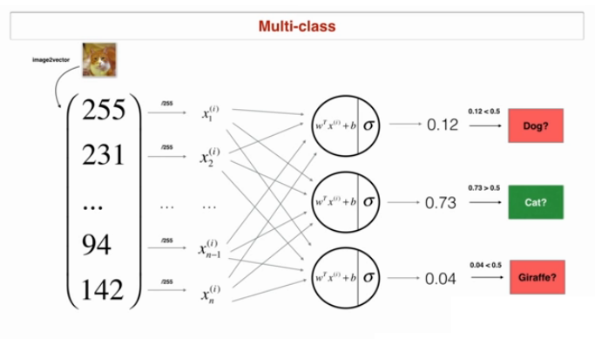
Copyright © www.ITbodhi.com

Slide 19
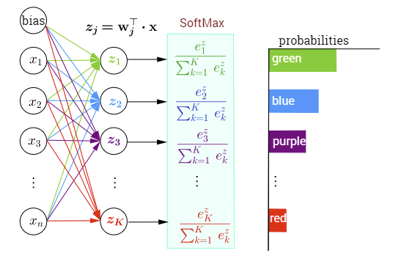
Copyright © www.ITbodhi.com

Slide 20
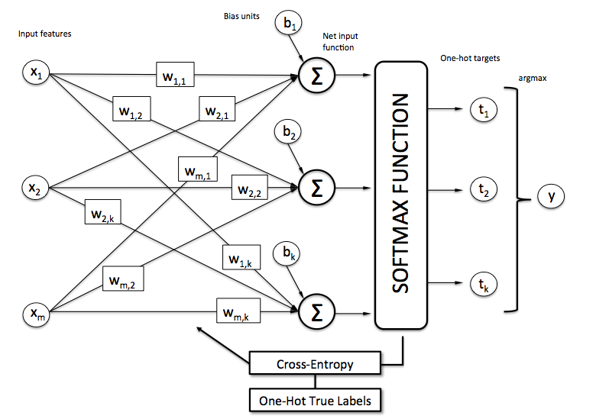
Copyright © www.ITbodhi.com

Slide 21
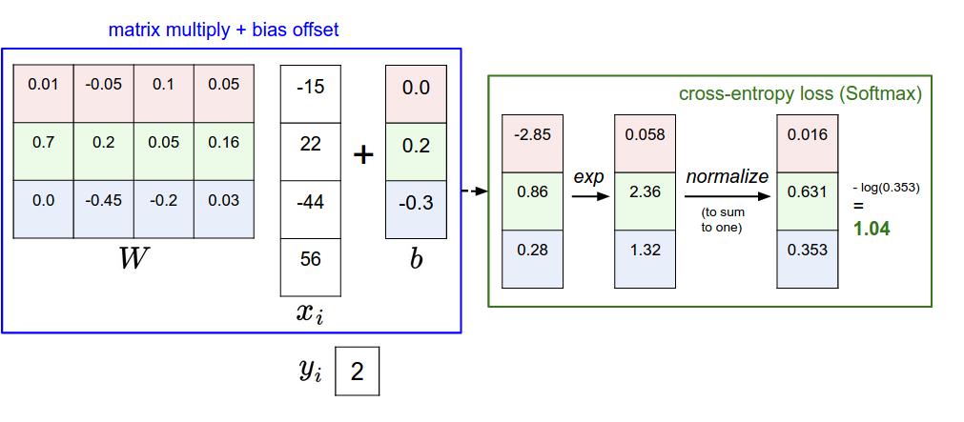
Copyright © www.ITbodhi.com
Copyright © www.ITbodhi.com

Slide 22
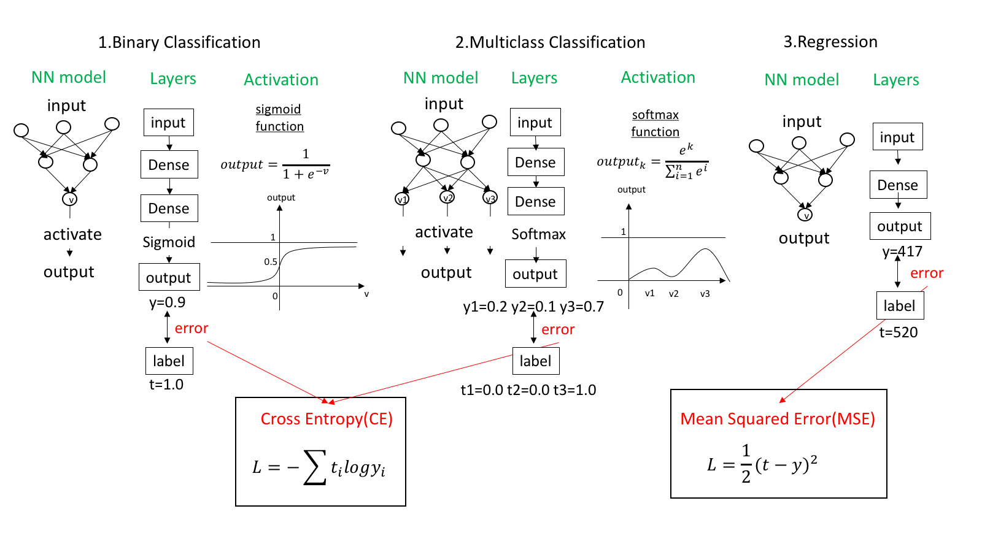
Copyright © www.ITbodhi.com

Slide 23
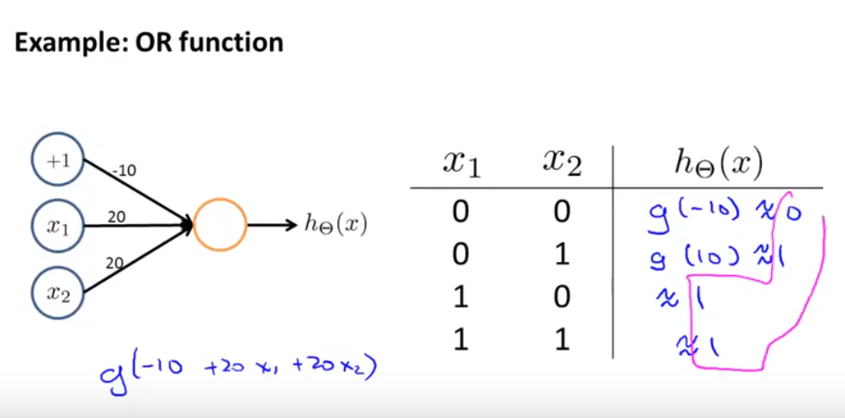
Single Neuron layer
Copyright © www.ITbodhi.com

Slide 24
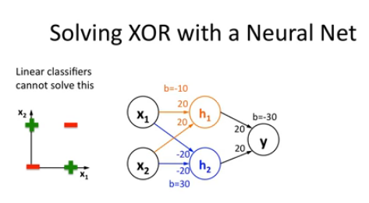
Multi Neuron layer
Copyright © www.ITbodhi.com

Slide 25
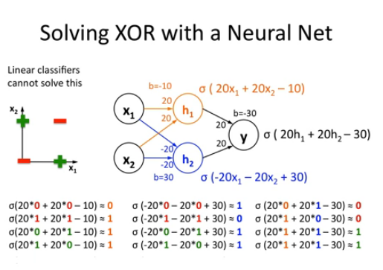
Multi Neuron layer
Copyright © www.ITbodhi.com

Slide 26
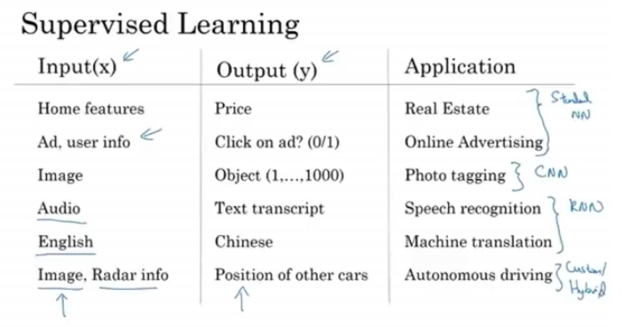
Copyright © www.ITbodhi.com

Slide 27
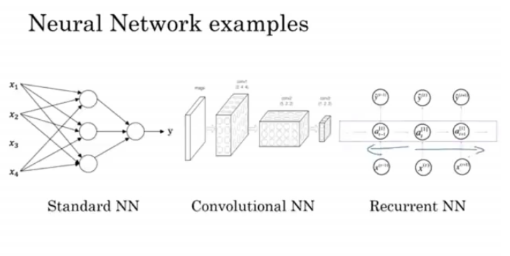
Copyright © www.ITbodhi.com

Slide 28
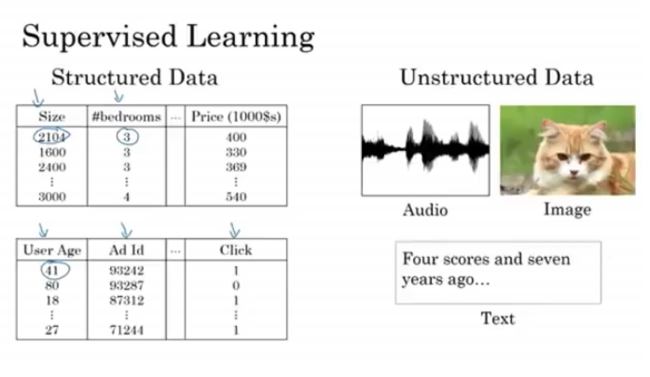
Copyright © www.ITbodhi.com

Slide 29
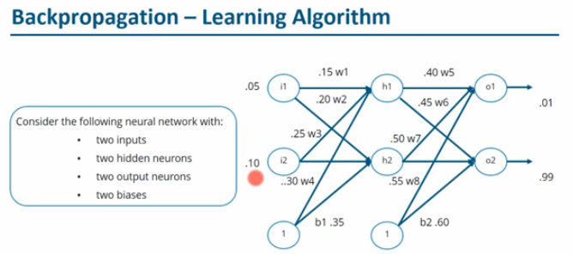
Copyright © www.ITbodhi.com

Slide 30
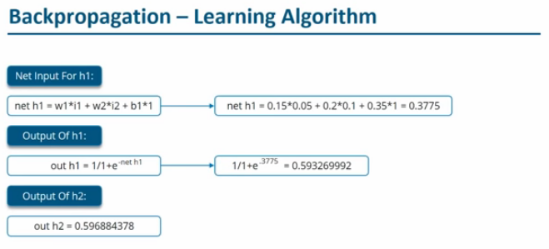
Forward Propagation
Copyright © www.ITbodhi.com

Slide 31
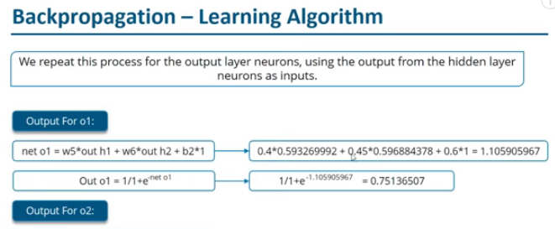

Forward Propagation
Copyright © www.ITbodhi.com

Slide 32
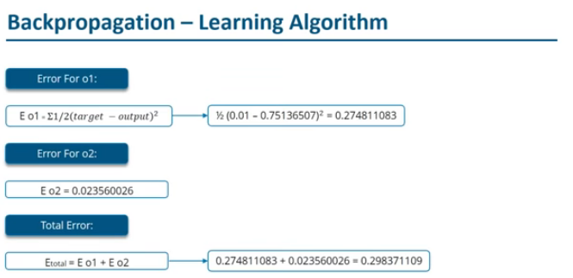
Forward Propagation
Copyright © www.ITbodhi.com

Slide 33
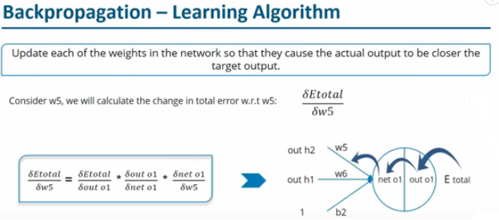
Backward Propagation
Copyright © www.ITbodhi.com

Slide 34
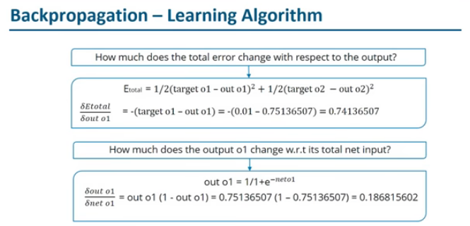
Backward Propagation
Copyright © www.ITbodhi.com

Slide 35
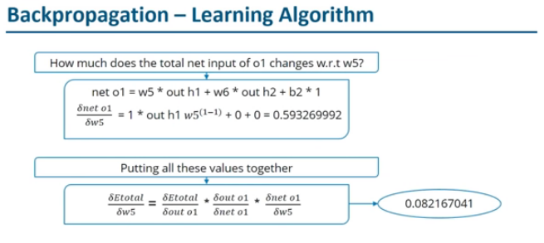
Backward Propagation
Copyright © www.ITbodhi.com

Slide 36
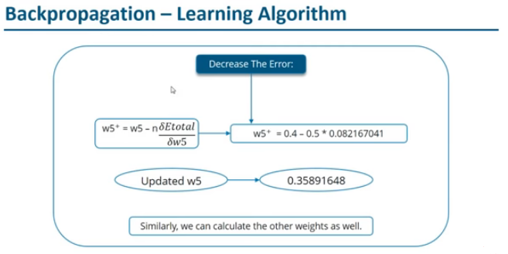
Backward Propagation
Copyright © www.ITbodhi.com

Slide 37
Activation Functions
Activation functions are mathematical equations that determine the output of a neural network.
The function is attached to each neuron in the network, and determines whether it should be activated (“fired”) or not, based on whether each neuron’s input is relevant for the model’s prediction.
Activation functions also help normalize the output of each neuron to a range between 1 and 0 or between -1 and 1.
An additional aspect of activation functions is that they must be computationally efficient because they are calculated across thousands or even millions of neurons for each data sample.
Modern neural networks use a technique called backpropagation to train the model, which places an increased computational strain on the activation function, and its derivative function.
Copyright © www.ITbodhi.com

Slide 38
Activation Functions
Activation Functions can be basically divided into 3 types:-
Binary Step Function
Linear Activation Function
Non-linear Activation Functions
ReLU,
Sigmoid
Tanh
Copyright © www.ITbodhi.com

Slide 39
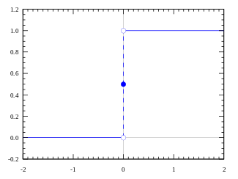
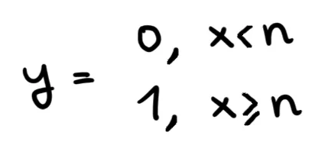
Activation Functions
Binary Step Function
Derivative of step function is 0. This means gradient descent won’t be able to make progress in updating the weights and backpropagation will fail.
Also do no support multiclassification problems.
Copyright © www.ITbodhi.com

Slide 40
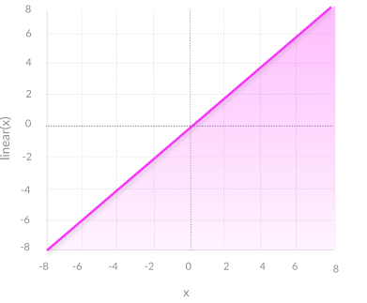
Activation Functions
Linear Function
A linear activation function takes the form:
A = cx
Two major problems:
Not possible to use backpropagation (gradient descent) to train the model—the derivative of the function is a constant, and has no relation to the input, X. So it’s not possible to go back and understand which weights in the input neurons can provide a better prediction.
All layers of the neural network collapse into one—with linear activation functions, no matter how many layers in the neural network, the last layer will be a linear function of the first layer (because a linear combination of linear functions is still a linear function). So a linear activation function turns the neural network into just one layer.
Copyright © www.ITbodhi.com

Slide 41
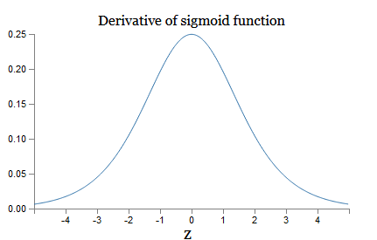

Activation Functions
Non Linear Function
Non-linear functions address the problems of a linear activation function:
They allow backpropagation because they have a derivative function which is related to the inputs.
They allow “stacking” of multiple layers of neurons to create a deep neural network. Multiple hidden layers of neurons are needed to learn complex data sets with high levels of accuracy.
1. Sigmoid Function
Advantages
Smooth gradient, preventing “jumps” in output values.
Output values bound between 0 and 1, normalizing the output of each neuron.
Clear predictions—For X above 2 or below -2, tends to bring the Y value (the prediction) to the edge of the curve, very close to 1 or 0. This enables clear predictions.
Disadvantages
Vanishing gradient—for very high or very low values of X, there is almost no change to the prediction, causing a vanishing gradient problem. This can result in the network refusing to learn further, or being too slow to reach an accurate prediction.
Outputs not zero centered.
Computationally expensive
Copyright © www.ITbodhi.com

Slide 42
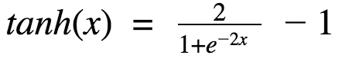
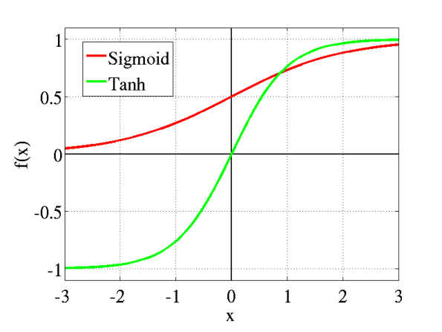
Activation Functions
2. TanH / Hyperbolic Tangent
tanh is also like logistic sigmoid but better.
The range of the tanh function is from (-1 to 1).
tanh is also sigmoidal (s - shaped)
Advantages
Zero centered—making it easier to model inputs that have strongly negative, neutral, and strongly positive values.
Otherwise like the Sigmoid function.
Disadvantages
Like the Sigmoid function
Copyright © www.ITbodhi.com

Slide 43
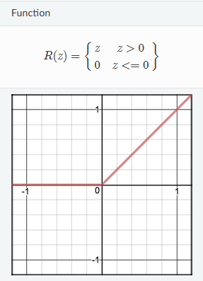
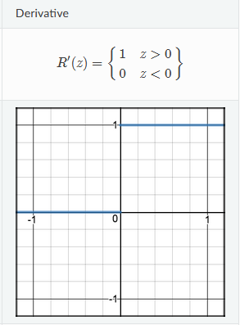
Activation Functions
3. ReLU (Rectified Linear Unit)
Advantages:
Computationally efficient—allows the network to converge very quickly
Non-linear—although it looks like a linear function, ReLU has a derivative function and allows for backpropagation
Sparsity of the activation. Fewer neurons are firing ( sparse activation ) and the network is lighter.
ReLu is less computationally expensive than tanh and sigmoid because it involves simpler mathematical operations.
Disadvantages:
The Dying ReLU problem—when inputs approach zero, or are negative, the gradient of the function becomes zero, the network cannot perform backpropagation and cannot learn.
The range of ReLu is [0, inf). This means it can blow up the activation.
Copyright © www.ITbodhi.com

Slide 44
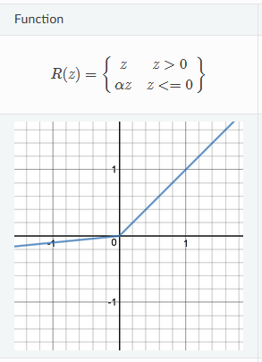
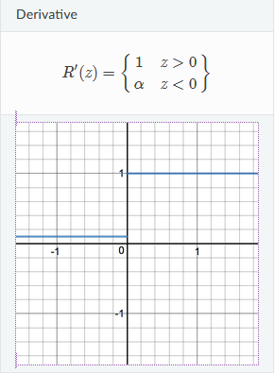
Activation Functions
4. Leaky ReLU
LeakyRelu is a variant of ReLU. Instead of being 0 when z<0, a leaky ReLU allows a small, non-zero, constant gradient α (Normally, α=0.01)
Advantages
Prevents dying ReLU problem—this variation of ReLU has a small positive slope in the negative area, so it does enable backpropagation, even for negative input values
Otherwise like ReLU
Disadvantages
Results not consistent—leaky ReLU does not provide consistent predictions for negative input values.
.
Copyright © www.ITbodhi.com

Slide 45
Activation Functions
4. Softmax
The softmax function is a generalization of the logistic function that “squashes” a -dimensional vector of arbitrary real values to a -dimensional vector of real values in the range that add up to .
Advantages:
Able to handle multiple classes only one class in other activation functions—normalizes the outputs for each class between 0 and 1, and divides by their sum, giving the probability of the input value being in a specific class.
Useful for output neurons—typically Softmax is used only for the output layer, for neural networks that need to classify inputs into multiple categories.
Copyright © www.ITbodhi.com

Slide 46
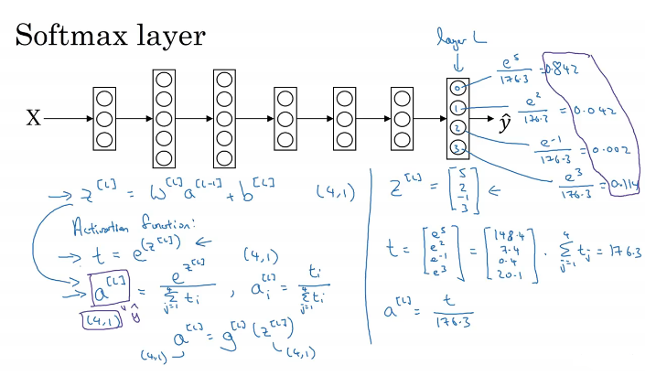
Activation Functions
4. Softmax
Copyright © www.ITbodhi.com

Slide 47
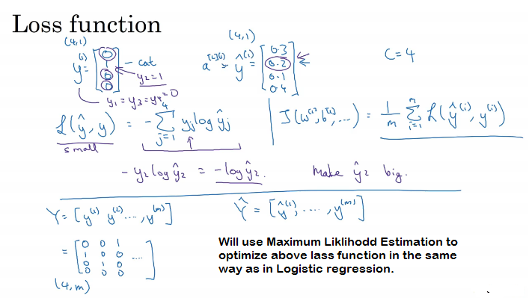
Activation Functions
4. Softmax
Copyright © www.ITbodhi.com

Slide 48
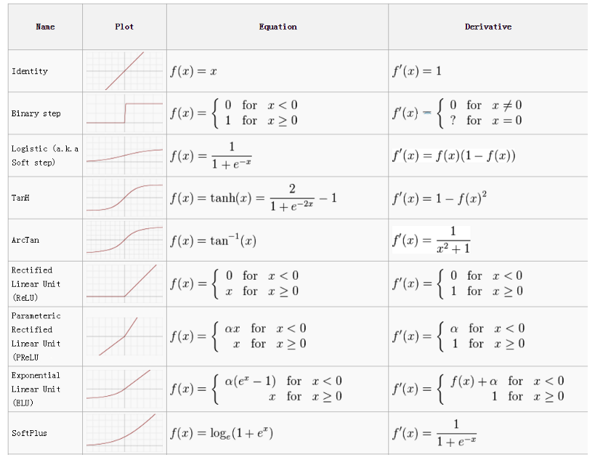
Activation Functions
Copyright © www.ITbodhi.com

Slide 49
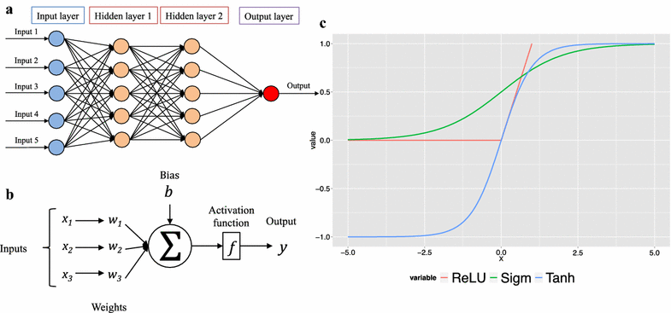
Activation Functions
Copyright © www.ITbodhi.com

Slide 50
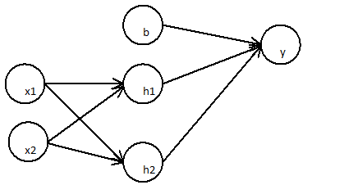
Why nonlinear Activation Functions ?
The first layer:
h1=x1∗wx1h1+x2∗wx1h2
h2=x1∗wx2h1+x2∗wx2h2
The subsequent layer
y=b∗wby+h1∗wh1y+h2∗wh2y
Can be simplified to
=b∗wby+(x1∗wx1h1+x2∗wx1h2)∗wh1y+(x1∗wx2h1+x2∗wx2h2)∗wh2y
=b∗wby+x1(wh1y∗wx1h1+wx2h1∗wh2y)+x2(wh1y∗wx1h1+wx2h2∗wh2y)
Is just a simple linear regression
=b∗W0+x1∗W1+x2∗W2
This can be shown to any number of layers, since linear combination of any number of weights is again linear. Any multilayer neural network will be as equal as simple linear regression!
What makes the difference to multilayer neural network is the non linearity that it gets from activation functions
Copyright © www.ITbodhi.com

Slide 51
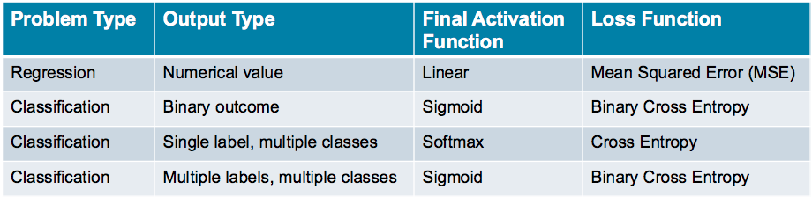
Activation & Loss function choice
Copyright © www.ITbodhi.com

Slide 52
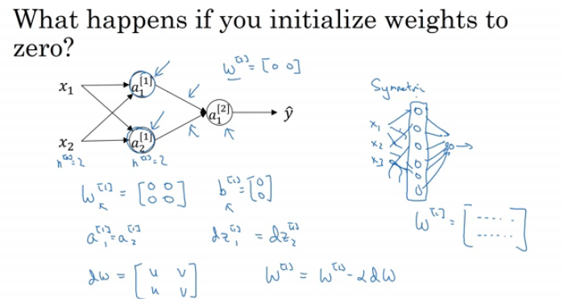
Initializing all weights to ZERO?
All weights calculated for a hidden layer will be same no matter how long the neural network is.
Copyright © www.ITbodhi.com

Slide 53

Initialize initial weights to very small?
So that if activation function is Sigmoid or Tanh then gradient should be within the high slope range otherwise learning will be very slow due saturation of slope.
Copyright © www.ITbodhi.com

Slide 54

Hyper parameters?
Number of hidden layers
Number of hidden units
Learning rate Alpha
Number of iterations
Choice of activation function
Mini batch size
Regularization Parameter
Momentum
Hit and Trial with experience
Not full proof method as of now.
Use random sampling and avoid grid search
Copyright © www.ITbodhi.com

Slide 55

Training/Cross Validation/Test data
Copyright © www.ITbodhi.com

Slide 56

Training/Cross Validation/Test data
Copyright © www.ITbodhi.com

Slide 57

Bias & Variance
Copyright © www.ITbodhi.com

Slide 58

Ultimate Goal → Low Bias and Low Variance → Bias & Variance trade off
High Bias (Train set performance) → Bigger NN, Better NN Architecture
High Variance (Test set performance) → More data, Regularization( Ridge/Lasso) , Better NN Architecture
Copyright © www.ITbodhi.com

Slide 59

Regularization technique to prevent overfitting
Hidden units at hidden payers as dropped randomly wrt the Probability of drop out.
Copyright © www.ITbodhi.com

Slide 60

Different random dropout for different training examples or gradient descent iterations.
a3 is matched to approx original value to avoid scaling problem during test phase.
No drop out at Test phase to rule out randomization in prediction.(Testing can be done with large number of test with random drop out and then take average of prediction but that is too costly.
Copyright © www.ITbodhi.com

Slide 61

Same effect as L2 regularization and weights are shrinked
Mostly used in computer vision due to large number of inputs.
Cost function is not well defined because it is changing in every itreration due to dropouts.
Copyright © www.ITbodhi.com

Slide 62

Augmentation Technique Regularization
Create more data using Flip, distortions etc.
Copyright © www.ITbodhi.com

Slide 63

Pros: Weight do not increase after stop.
Better to apply L2 regularization technique.
Copyright © www.ITbodhi.com

Slide 64

By normalizing all of our inputs to a standard scale, we're allowing the network to more quickly learn the optimal parameters for each input node.
Rescaling the distribution of values so that the mean of observed values is 0 and the standard deviation is 1
Also called Data Standardization or Whitening
Two steps process: Subtract Mean & Normalize Variance
Same mean and variance has to be used for Test data as of Train data to avoid scaling problem.
Copyright © www.ITbodhi.com

Slide 65

Normalize inputs
If inputs are not normalized then error graph will be skewed and will take more time to converge.
Copyright © www.ITbodhi.com

Slide 66

Vanishing Gradient Descent
Copyright © www.ITbodhi.com

Slide 67


Vanishing Gradient Descent
Copyright © www.ITbodhi.com

Slide 68

Copyright © www.ITbodhi.com

Slide 69


Copyright © www.ITbodhi.com

Slide 70

Exploding Gradient Descent
Copyright © www.ITbodhi.com

Slide 71

Copyright © www.ITbodhi.com

Slide 72

Initializing NN weights to avoid gradient vanishing and explode
Zero initialization: All weights calculated for a hidden layer will be same no matter how long the neural network is.
Random initialization: Prone to gradient vanishing and explode.
He initialization : we just simply multiply random initialization with for Relu activation function.
Copyright © www.ITbodhi.com

Slide 73


Initializing NN weights to avoid gradient vanishing and explode
Xavier initialization : It is same as He initialization but it is used for tanh() activation function, in this method 2 is replaced with 1.
They set the weights neither too much bigger than 1, nor too much less than 1. So, the gradients do not vanish or explode too quickly. They help avoid slow convergence, also ensuring that we do not keep oscillating off the minima.
Copyright © www.ITbodhi.com

Slide 74

Optimization of Gradient Descent method:
Copyright © www.ITbodhi.com

Slide 75

Copyright © www.ITbodhi.com

Slide 76

Optimization of Gradient Descent method:
Typical mini batch size are power of 2 → 64,128,512,1024 etc.
Copyright © www.ITbodhi.com

Slide 77

Optimization of Gradient Descent method:
Copyright © www.ITbodhi.com

Slide 78


Copyright © www.ITbodhi.com

Slide 79

Copyright © www.ITbodhi.com

Slide 80

Optimization of Gradient Descent :Exponential weighted average
Copyright © www.ITbodhi.com

Slide 81

Optimization of Gradient Descent :Exponential weighted average
Copyright © www.ITbodhi.com

Slide 82

Optimization of Gradient Descent :Exponential weighted average
Copyright © www.ITbodhi.com

Slide 83

Copyright © www.ITbodhi.com

Slide 84

Optimization of Gradient Descent :Exponential weighted average
Copyright © www.ITbodhi.com

Slide 85

Copyright © www.ITbodhi.com

Slide 86

Optimization of Gradient Descent : Gradient Descent with momentum
Faster than gradient descent algorithm.
Uses Exponential weighted averages of gradients to update the weights.
Copyright © www.ITbodhi.com

Slide 87

Optimization of Gradient Descent : Gradient Descent with momentum
Copyright © www.ITbodhi.com

Slide 88

Copyright © www.ITbodhi.com

Slide 89

Optimization of Gradient Descent : RMSprop : Root Mean Square Prop
Copyright © www.ITbodhi.com

Slide 90

Copyright © www.ITbodhi.com

Slide 91


Optimization of Gradient Descent : Adam
Update to RMSprop algorithm.
Gradient descent with momentum + RMSprop
Copyright © www.ITbodhi.com

Slide 92

Copyright © www.ITbodhi.com

Slide 93

Optimization of Gradient Descent : Learning Rate Decay
Idea is to decrease learning rate(alpha) after each mini batch so that oscillation should be near to the convergence point as much a possible.
Copyright © www.ITbodhi.com

Slide 94

Optimization of Gradient Descent : Learning Rate Decay
Copyright © www.ITbodhi.com

Slide 95

Hyper parameter tuning:
Copyright © www.ITbodhi.com

Slide 96

Copyright © www.ITbodhi.com

Slide 97

Idea is to Normalize output of hidden layers so that weight optimization for the next layer is faster.
Generally normalize the regression part before activation function applied.
Copyright © www.ITbodhi.com

Slide 98


Batch Normalization:
Idea is to Normalize output of hidden layers so that weight optimization for the next layer is faster.
Generally normalize the regression part before activation function applied.
We do not want mean and variance always 0 and 1 to take advantage of non linearity, so let the model learn what are the best values.
Copyright © www.ITbodhi.com

Slide 99

Copyright © www.ITbodhi.com

Slide 100

Copyright © www.ITbodhi.com

Slide 101

Copyright © www.ITbodhi.com

Slide 102

Copyright © www.ITbodhi.com

Slide 103

Copyright © www.ITbodhi.com

Slide 104


Copyright © www.ITbodhi.com

Slide 105

Copyright © www.ITbodhi.com

Slide 106

Copyright © www.ITbodhi.com

Slide 107

Batch Norm at Test Time:
At test time you test prediction one data at a time so Mean and variance calculated would not make any sense on a single record.
So exponentially average of mean and variance on all the layers are calculated and latest value at that layer would be used at test time.
Copyright © www.ITbodhi.com

Slide 108


Something Interesting about Deep Learning:
ADA is very useful for faster learning because of plateaus problem in high dimensions.
Copyright © www.ITbodhi.com

Slide 109

Improving performance of a better deep learning model:
Copyright © www.ITbodhi.com

